Slide 1
IAD's State - Tribal Finance Engagement Meeting
Presentation By:
Nicole Macias – State Budget Division
Wesley Billingsley – Infrastructure Planning & Development Division
Carmen Morin – Local Government Division

Slide 2
Historical Overview
Agency Operating Budget Deadlines
Deadlines Summer: Agencies prepare budget requests; Executive agencies consult with Governor’s Office and DFA on priorities
Sept 1: Agency operating budget request due, including special (nonrecurring) appropriations)
First week of January: LFC and executive budget recommendations released for upcoming legislative session. Agencies participate in budget hearings.
May 1: Agency operating budget submissions due for fiscal year beginning July 1
Budgeting nonrecurring appropriations: Depends on when appropriation is valid according to language in HB2. Some can be budgeted as soon as HB2 as signed, others not until the start of the next FY. Agencies are strongly encouraged to budget them as soon as possible to give the most time to spend them, which again may depend on HB2 language.

Slide 3
Historical Overview
DFA Tribal Liaison – Nicole Macias
Principal Executive Budget and Policy Analyst in the State Budget Division
Maintain the government-to-government relationships outlined in New Mexico's State-Tribal Collaboration Act
Provide support to DFA leadership and Tribal partners when requested as it relates to Capital Outlay, TIF, and other sources of department funding
Contact Information:
Cell: 505-699-0065
Email: Nicole.Macias@dfa.nm.gov

Slide 4
Historical Overview
State Agency Capital Outlay Request Deadline
Deadlines for submitting Capital Outlay Requests
Deadline to request capital funding from Legislators is Friday, December 12 at 3pm
Deadline to request capital funding from Governor is Monday, December 15 at 5pm
Legislator capital projects requests are submitted through the LCS website at https://www.nmlegis.gov/Legislation/BillFinder/Capital_Outlay_Request_Forms
Governor capital projects requests are submitted through the LCS website at https://www.governor.state.nm.us/request-capital-outlay/
For questions about Legislator requests - Sheila Keleher @ Sheila.Keleher@nmlegis.gov
For questions about Governor requests – Jesse Guillen @ Jesse.Guillen@dfa.nm.gov

Slide 5
Historical Overview
Reauthorization Deadlines
Deadline for submitting Reauthorization Spreadsheet
Deadline to request reauthorization from Legislators is Sunday, February 1
Deadline to request reauthorization from Governor is Friday, December 12
Reauthorization of Governor funded capital projects are submitted to the Department of Finance & Administration (DFA) through a spreadsheet
Reauthorization of Legislator funded capital projects are submitted through the LCS website @ https://www.nmlegis.gov/Legislation/BillFinder/Capital_Outlay_Request_Forms
For questions to LCS – Sheila Keleher @ Sheila.Keleher@nmlegis.gov
For questions or to submit the spreadsheet - Tonantzin Roybal @ Tonantzin.Roybal@dfa.nm.gov

Slide 6
Historical Overview
CAPS Questionnaire Deadline for General Fund
(Fall Cycle)
November 28th: 1st Deadline for submitting Questionnaires in CAPS
December 12th: 2nd Deadline for follow-up submittals (final deadline)
Questionnaires that were not previously submitted during prior questionnaire cycles; or
Capital appropriations that were not previously budgeted due to audit compliance, anti-donation concerns or were not ready to proceed.
General Fund budgets will be established through an automated budget upload sometime in January.
For questions regarding questionnaires – Scott Wright @ Scott.Wright@dfa.nm.gov

Slide 7
Historical Overview
CAPS Questionnaire Deadline for General Fund (Spring Cycle)
Coming Spring 2026
Questionnaires for projects funded during the 2026 Legislative Session;
Questionnaires that were not previously submitted during prior questionnaire cycles; or
Capital appropriations that were not previously budgeted due to audit compliance, anti-donation concerns or were not ready to proceed.
General Fund budgets will be established through an automated budget upload sometime in January.
For questions regarding questionnaires – Scott Wright @ Scott.Wright@dfa.nm.gov

Slide 8
Historical Overview
CAPS Quarterly Reporting Deadline
December 31st: Deadline for submitting quarterly reports in CAPS
Quarterly reports for all open capital projects should be submitted each quarter
These reports should include any activity that has occurred during Q2
If no activity has occurred during Q2, please check the box indicating there was no activity
If an appropriation needs to be closed in CAPS, please make sure the balance is $0 and the project is marked as Project Closed.
For questions regarding quarterly reports for State Agencies – Ryan Serrano @ RyanS.Serrano@dfa.nm.gov

Slide 9
Historical Overview
CAPS Infrastructure Capital Improvement Plan (ICIP) Deadline
July 1st: Deadline for submitting 2028-2032 ICIP in CAPS
All infrastructure capital improvement plan projects
Ensure all projects are approved by the governing board
There will be time for editing or amending from July 2 through September 30
Final list will go to Legislative Council Services and be published in October
For questions regarding ICIPs – Mary Ann Maestas @ Maryann.Maestas@dfa.nm.gov

Slide 10
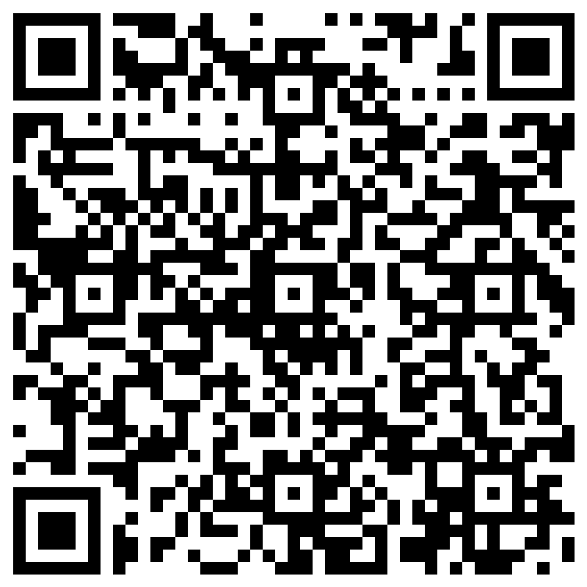
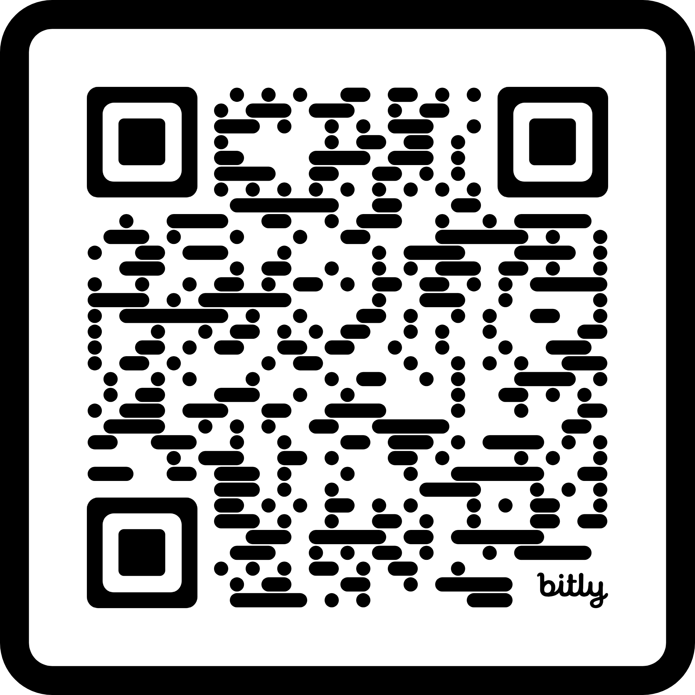
Technical Assistance
Funding Navigation Intake
Funding Navigation
Help you identify alternative/additional funding for your infrastructure projects
Have emergency funding needs? Fill out the intake form to be connected with possible sources of emergency funds
Rural/Frontier Equity Ombuds
Federal Grants Bureau
Works with rural communities as resource navigators and advocates
Supports the acquisition and management of federal grants
Email federal.grant@dfa.nm.gov to get assistance
Rural/Frontier Equity Ombuds Intake

Slide 11
Grant Programs
New Mexico Match Fund- rolling deadline
Matching Grant –Funding to meet the minimum match requirement for a federal grant. 40% of available funds are reserved for rural, frontier, and tribal governments
Project Implementation Grant – For recipients of a Matching Grant that require capacity funding to fully implement the federally funded project associated with the Matching Grant.
Federal Compliance Offset Grant – Funding for projects that demonstrate higher project costs due to compliance with federal funding requirements
Community Development Program Fund (CDPF)- next application cycle in the fall of 2026
Grant funds may be used for planning and design for projects with a total cost of greater than $5 million or complete projects/useable phases with a total cost of less than $5 million.

Slide 12
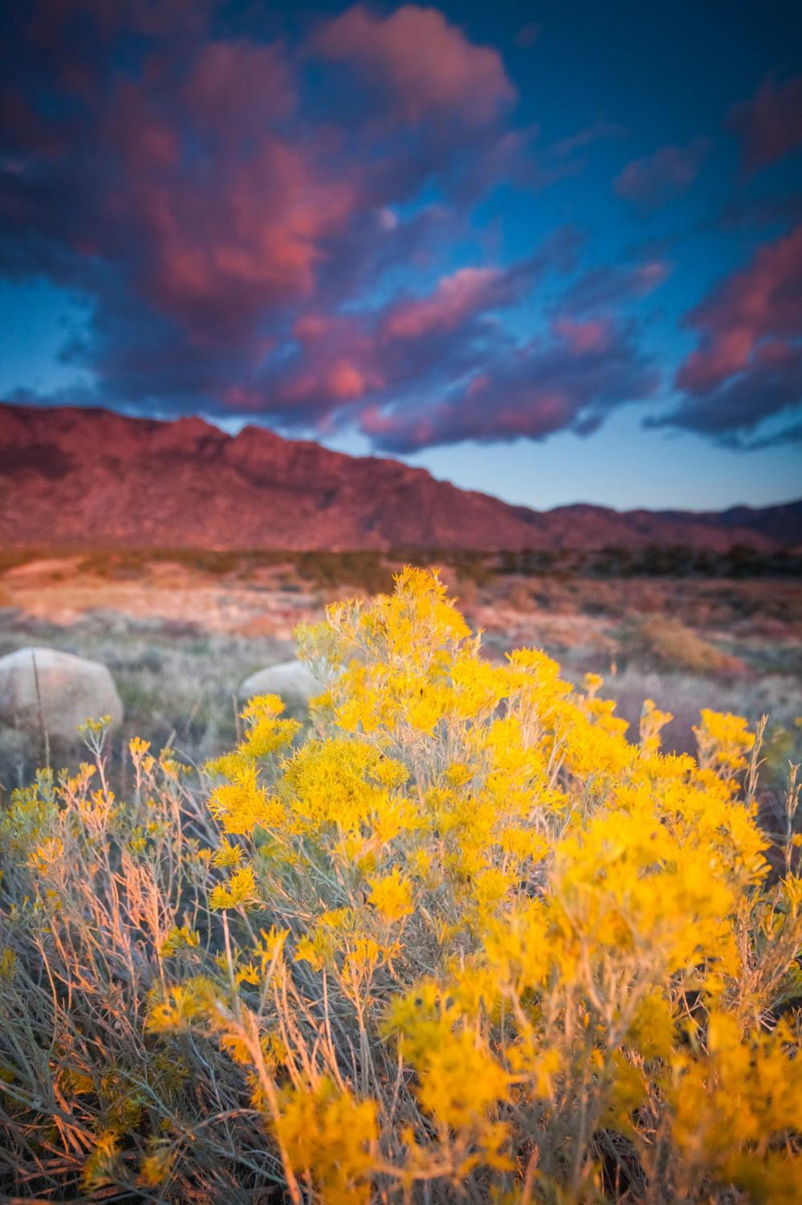

PARS (Project Accountability Reporting System)
New Pilot System for DFA
A centralized, unified system designed for managing grant agreements, notices of obligation (NOOs), and pay requests.
The system is accessible from an internet browser at platform.dfa.nm.gov
Multi-factor authentication by text or email is required
This may be one of multiple modules a user will have access to

Slide 13


Entity User Roles
PARS allows for two entity roles:
Entity Initiator
An Entity Initiator can initiate NOOs and Pay Requests for
projects the entity oversees.
Entity Approver
An Entity Approver can approve or deny NOOs and Pay Requests
initiated by Entity Initiator for project the entity oversees.
If a request is denied by an Entity Approver or Local Government Division, the Entity Initiator will receive notification and have the ability to correct or delete the submission.
Dual Role
A Dual Role can act as an Entity Initiator or Entity Approver, but they can not take more than one action on a request.

Slide 14
CAPS Role in the Future
System
Integration
CAPS (ICIP)
Capital Outlay Requests
Questionnaires
Audit Compliance
PARS (grant agreements, NOOs, pay requests)
CAPS (reporting)

Slide 15


Thank you!
Your LGMB Team!
Dawn Webster | Senior Legislative Grant Manager | 505-487-6420
Daniel Catanach | Grant Manager | 505-231-6090
Geovanna Losito | Grant Manager | 505-257-8098
Lori Vasquez | Grant Manager | 505-469-6175
Lynda Martinez | Grant Manager | 505-699-3971
Melody Zamora | Grant Manager | 505-670-4395
Melanie Viarrial | Grant Manager | 505-690-1561
Nick Apodaca | Grant Manager | 505-795-2002
Tony Duran | Grant Manager | 505-618-0734
Frances Johnson- Sandoval | Grant Manager | 505-618-0640
Cecilia Mavrommatis, Division Director
505-690-5470; Cecilia.Mavrommatis@dfa.nm.gov
Jeannette Gallegos, Deputy Director
505-660-8744; Jeannette.Gallegos@dfa.nm.gov
Carmen Morin, Bureau Chief
LGD Legislative Grant Management Bureau (LGMB)
505-470-8979; CarmenB.Morin@dfa.nm.gov

