Slide 1

Transportation Project Fund, Local Government Road Fund, and Capital Outlay
December 11, 2025
Cabinet Secretary, Ricky Serna

Slide 2

Transportation Project Funds (TPF)
100% State Funding: 95% State Match, 5% Local Entity Match
Disbursement based
Resolution of sponsorship from entity's governing body required, indicating the availability of the proposed match
All grants awarded funds must be spent no later than 30 months from the effective date of the grant agreement
Final project selection and funding amounts will be determined by the State Transportation Commission
Eligible projects: environmental and other studies, planning, design, construction and acquisition of rights of way necessary for the development of transportation infrastructure, and includes highways, streets, roadways, bridges, crossing structures, parking facilities, including all areas for vehicular, transit, bicycle or pedestrian use for travel, ingress, egress and parking.

Slide 3
TPF Call for Projects
January - Call for Projects letter sent to all Metropolitan Planning Organizations (MPO) and Regional Transportation Planning Organizations (RTPO).
  Only counties, municipalities, and tribal entities are eligible to apply for TPF funds
Local Entities must submit their applications to their MPO/RTPO for review and ranking.
MPO/RTPO’s will meet with NMDOT staff to review applications and obtain any require signatures.
After MPO/RTPO and NMDOT review MPO/RTPO will upload final applications to NMDOT’s FTP server.
  Deadline to submit application is May 31st of each year by 5 pm.

Slide 4
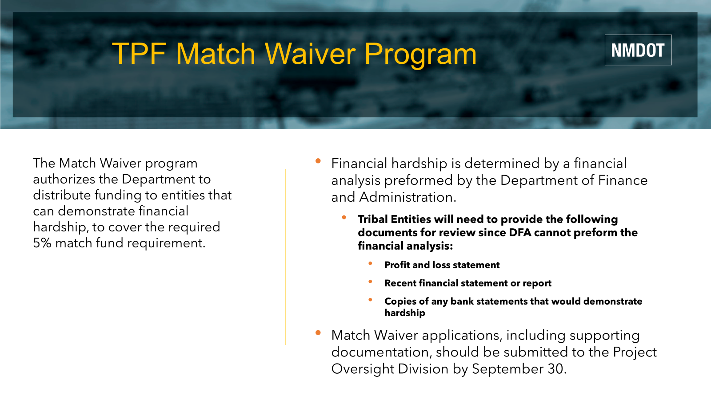

TPF Match Waiver Program
The Match Waiver program authorizes the Department to distribute funding to entities that can demonstrate financial hardship, to cover the required 5% match fund requirement.
Financial hardship is determined by a financial analysis performed by the Department of Finance and Administration.
  Tribal Entities will need to provide the following documents for review since DFA cannot perform the financial analysis:
    Profit and loss statement
    Recent financial statement or report
    Copies of any bank statements that would demonstrate hardship
Match Waiver applications, including supporting documentation, should be submitted to the Project Oversight Division by September 30.

Slide 5
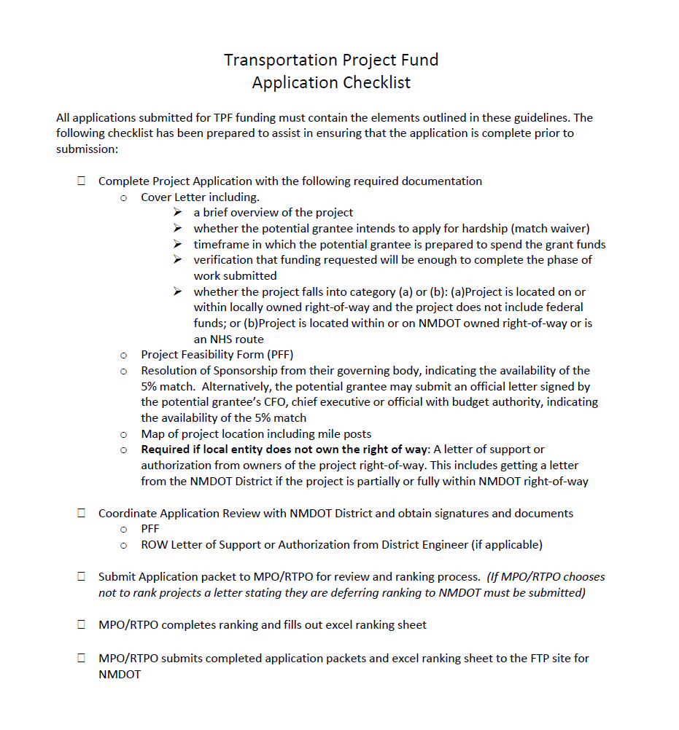
TPF Application Packet Checklist

Slide 6
Local Government Road Fund (LGRF)
100% State Funding: 75% State Match, 25% Local Entity Match (Disbursement based)
Funding used for project development, construction, reconstruction, improvement, maintenance or repair of public highways, streets, ROW acquisition
Due to limited nature of available funding in this program, maintenance projects are better suited for these awards
Tribes eligible for Coop 4% subsection of LGRF, which funding is distributed between 6 Districts
January - Call for Projects letter sent to Local Entities asking for their project proposals for the new LGRF year outlining required application documents.
Project Proposals are due by March 15th. Incomplete proposals or late proposals will be returned for resubmittal next year.
The State Transportation Commission reviews and approves the projects recommended for funding
Projects shall be fully executed by October 31 of the current fiscal year

Slide 7
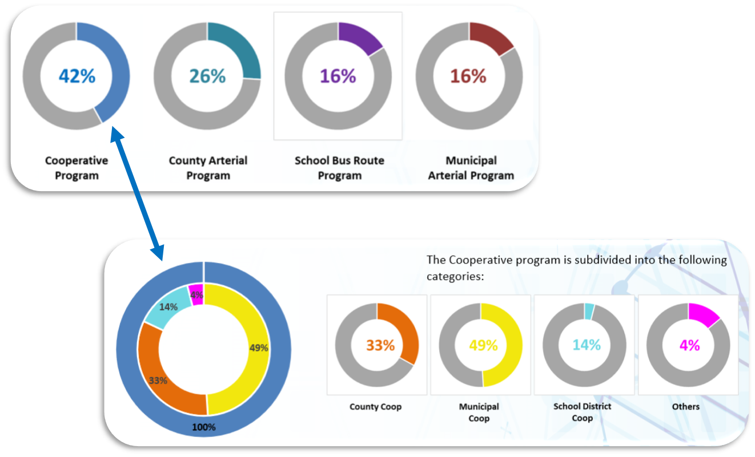
LGRF Program Percentages
Tribal entities are eligible for the 4% subcategory of the Cooperative Program

Slide 8

Capital Outlay Funding
These are 4-year awards, but at least 10% of the award must be obligated (under 3rd-party contract) within one (1) year after bond sale or general fund approval.
Local entity also must spend at least eighty-five percent (85%) of the bond proceeds within three (3) years after the bond is sold
There is no Local Government Match on Capital Outlay awards.
Funding can be used for drainage, road rehabilitation and construction, airport improvements, bridge improvements, lighting, traffic calming/signalization, pedestrian infrastructure including multi-use paths, landscaping. (Planning and design is allowed but must be spelled out in the project scope).
Non-eligible expenses include per-diem, application fees, and other admin/operating expenses.
This is a reimbursement program – the Local Government is reimbursed for their costs after they pay their 3rd-party contractors.
In New Mexico, State Capital Outlay is authorized by the Legislature and is generally non-recurring
2.61.6 NMAC outlines the appropriate scope language to be used on transportation-related Capital Outlay requests

Slide 9
Capital Outlay Process
New Mexico Legislature
  Awards projects funded with Severance Tax Bonds (STB) or General Funds (GF) depending upon budget availability.
Once Capital appropriations are approved the Department of Finance and Administration (DFA) or State Board of Finance (SBOF) notify Entities to complete Severance Tax Bond/GF Certification Questionnaires on DFA’s web-based system.
After questionnaires have been reviewed and approved NMDOT will issue grant agreements when the following are met:
  STB projects – must go through the bond sale process
    Bond sales occur in June and December
  GF projects - grant agreements may be issued upon approval of questionnaire and budget upload.
Upon execution of grant agreements Entities may begin advertising the project and selecting a contractor and/or professional services provider.
Once selected, Entity provides a copy of the Third-Party Agreement with provider, along with a Notice of Obligation Form (NOO) to the NMDOT District Coordinator

Slide 10
Capital Outlay Process continued
NMDOT District Coordinator
  Reviews the Third-Party Agreement
  Approves NOO in the amount of the Third-Party Agreement (cannot issue NOO for more than the full amount of the Capital Outlay Award)
  A copy of the NOO goes to the Local Entity and another to Project Oversight Division.
NMDOT Program Oversight Division (POD)
  Prepares a Purchase Order (PO) in the amount NOO and sends a copy to District Coordinator
Local Entity
  Upon receipt of NOO – completes the execution of the Third-Party Agreement and can now proceed with the construction and or design of the project

Slide 11
Challenges Faced
Resources
Turnaround time on agreements and amendments
External processes add more time to obtaining required documentation and signatures
Reauthorizations are not guaranteed, jeopardizing project completion
Not engaging with MPO/RTPO/ Navajo DOT early in planning stage of projects
Capacity in staff to manage and oversee multiple grants/funding
Timely submissions of Notice of Obligations to encumber Capital Funding
NMDOT Local Government sections, housed in all Districts, assist in the process for timely reimbursements and consultation
State Funding Coordinator: Oversees TPF, LGRF, Capital Outlay
NMDOT Training available for TPF, LGRF, and Capital Outlay, as they follow different funding cycles, process to request funds
Capital Outaly forms and training materials can be found on DFA's website at: https://www.nmdfa.state.nm.us/infrastructure-planning-and-development-division/
NMDOT's 100% State Funding Handbook can be found on NMDOT's website at: https://www.dot.nm.gov/business-support/project-oversight-division/t-lpa-documents-and-information/

Slide 12
NMDOT Contact Information
Statewide Coordinator Santa Fe
  • Clarissa Martinez
  • State Grant Manager
  • Phone- 505.699.9946
  • Clarissa.Martinez@dot.nm.gov
District Coordinators
  District 1: Debra Hudson
  Phone- 575.640.2779
  DebraA.Hudson@dot.nm.gov
  District 2: Libby Coslin
  Phone- 575.840.3373
  Libby.Coslin2@dot.nm.gov
  District 3: Peter Kubiak
  Phone- 505.249.5718
  Peter.Kubiak@dot.nm.gov
  District 4: John Herrera
  Phone- 505.617.1020
  JohnA.Herrera@dot.nm.gov
  District 5: Amanda Nino
  Phone- 505.660.6357
  Amanda.Nino@dot.nm.gov
  District 6: Kyle Slim
  Phone- 505.240.1669
  Kyle.Slim@dot.nm.gov

