Slide 1
STATE-TRIBAL FINANCE ENGAGEMENT
Indian Affairs department
December 11, 2025

Slide 2
CAPITAL OUTLAY AND TRIBAL INFRASTRUCTURE funding
2

Slide 3
Intergovernmental Agreements (IGA’s)
capital outlay & tribal infrastructure fund
Intergovernmental Governmental Agreement (IGA) – lays out the appropriation amount, project description, term, guidance on reporting, allowable expenses, reimbursements, conditions, restrictions
Issued upon establishment of budgets as authorized by State legislation and Uniform Funding Criteria (UFC) and compliance with the Public Finance Accountability Act, NMSA 1978, §6-3B-1 et seq.)
Tribal Capital Outlay Agreement Template is available here, under “Grant Agreement Forms”: https://www.nmdfa.state.nm.us/infrastructure-planning-and-development-division/
5% of Appropriation Amount must be obligated via Notice of Obligation (NOO) within six months of the IGA Effective Date.
85% of Appropriation amount must be expended no less than six month prior to the IGA Reversion Date.
Agency uses the NOO to encumber appropriation funds in compliance with State’s Model of Accounting practices, State Procurement Rules, State Board of Finance Disbursement Rules
CO/TIF Administrators will work with Grantees on specific requirements for the NOO.
UFC’s – Annual Financial Audit shall be forwarded to IAD for review annually. IAD then forwards to DFA/Infrastructure Planning & Development Division for certification
(Best practice: submit Audit to IAD at the same time as it is submitted to OMB.)
3

Slide 4
Intergovernmental Agreements (IGA’s)
capital outlay & tribal infrastructure fund
REQUEST FOR PAYMENT (RPF)
ARTICLE VI(A)(2)
PROOF OF PAYMENT
Each RFP must contain proof of payment by the Grantee or liabilities incurred by the Grantee showing that the expenditures are valid or are liabilities incurred by the Grantee in the form of actual unpaid invoices received by the Grantee for services rendered by a third party or items of tangible personal property received by the Grantee for the implementation of the Project; provided, however, that the Grantee may be reimbursed for unpaid liabilities only if the Department, in its sole and absolute discretion, agrees to do so and in accordance with any special conditions imposed by the Department.
4

Slide 5
Intergovernmental Agreements (IGA’s)
capital outlay & tribal infrastructure fund
REQUEST FOR PAYMENT (RPF)
ARTICLE VI(A)(3)
UNPAID INVOICE
3. Should the Grantee submit an RFP to the Department based upon an invoice received from a third-party contractor or vendor, but not yet paid by the Grantee, the Department may provide payment for that unpaid invoice to Grantee. The unpaid invoice must comply with the provisions of this Agreement and are a valid liability of the Grantee. Within five (5) business days of receipt of payment by the Department to the Grantee, the Grantee shall make the payment to the third-party contractor or vendor. The Grantee is required to certify to the Department proof of payment to the third-party contractor or vendor within ten (10) business days from the date of receiving reimbursement from the Department. The Department reserves the right to make such payment directly to the third-party contractor or vendor, as a special consideration of this Agreement.
5

Slide 6
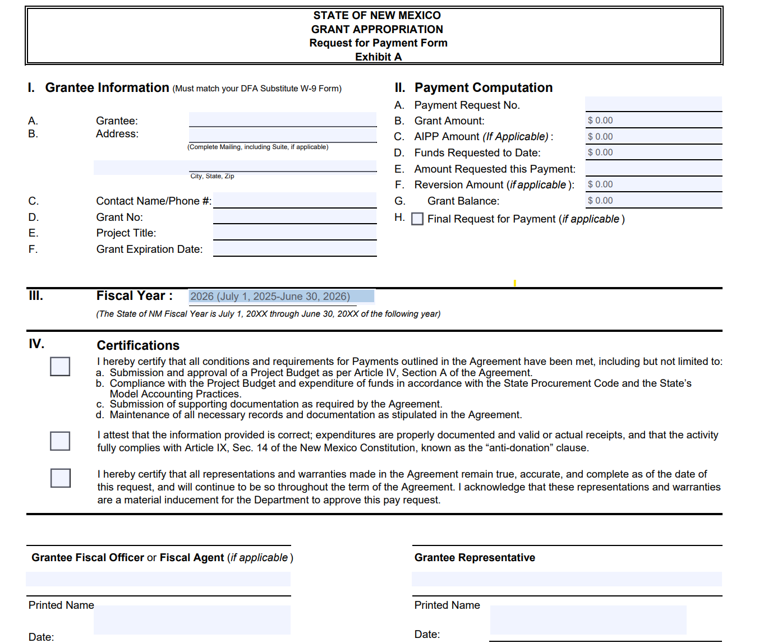
Requests for payment – capital outlay & tribal infrastructure fund
https://www.nmdfa.state.nm.us/infrastructure-planning-and-development-division/
https://www.nmdfa.state.nm.us/wp-content/uploads/2025/07/Exhibit-A-Capital-Grant-Request-For-Payment-Form.pdf
6

Slide 7
Requests for payment – capital outlay & tribal infrastructure fund important dates / timelines
Quarterly - Project Activity in CAPS:
March 31st
June 30th
September 30th
December 31st
Annual Audit submitted nine months after fiscal year end
RFP’s shall be submitted:
Immediately as received, but no later than 30 days after expenditure is in incurred by grantee
20 days from date of Early Termination
20 days from Reversion Date
State Fiscal Year End – no later than July 20th to meet State Board of Finance draw deadlines and end of fiscal year deadlines for reverting projects
Submit RFPs via email to Project Administrator and copy: IADAccountsPayable@iad.nm.gov
Timeline to receive payment:
Due to required internal and external review and approvals, payments could take up to six weeks. Though, the Agency works diligently to make payments as quickly as possible.
7

Slide 8
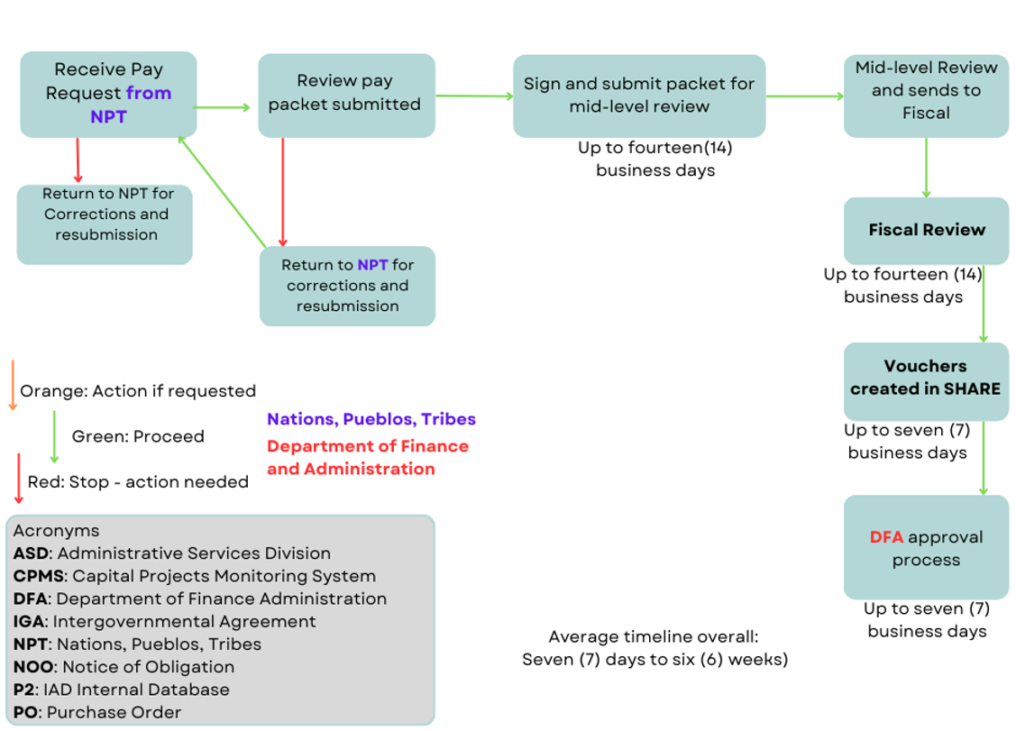
capital outlay payment process
8

Slide 9
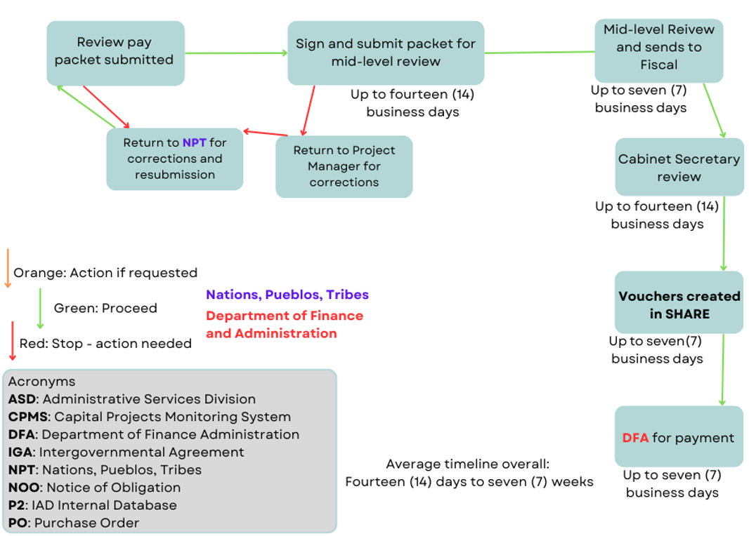
tribal infrastructure fund payment process
9

Slide 10
Programmatic funding
Recurring funds, Tobacco cessation, government results and opportunity (GRO), Special Appropriations
10

Slide 11
Programmatic funding
Funding Opportunities – on IAD’s website
Notice of Funding
Request for Proposals
https://www.iad.nm.gov/programs-and-funding/iad-grants-rfps-and-rfqs/
Awards will use the Procurement Contract Process
Contract will lay out the Scope of Work, project description, deliverables, term, compensation, guidance on reporting, allowable expenses, indirect costs limitations, reimbursements, conditions, restrictions, etc.
Article 17 “The laws of the State of New Mexico shall govern this agreement…”
Compliance with State’s Model of Accounting practices, State Procurement Rules, NM Administrative Code, Legislative appropriation language.
11

Slide 12
Programmatic funding
Utilize Request for Payment form, unless otherwise instructed.
NMSA 1978, § 6-5-6(C) - A state agency shall determine that a proposed expenditure is for a public benefit and purpose consistent with the related appropriation and is necessary to carry out the statutory mission of the state agency prior to committing the state to the transaction.
Requests may be sent via email to Program Manager and copy IADAccountsPayable@iad.nm.gov
Payments shall be made within 30 days after the date of acceptance and certification of expenditures by the Program Manager.
Contracts with a term date of June 30th require submission of final request for payment no later than July 15th
12

Slide 13
General QUESTIONS & ANSWERS
What is the timeline for reimbursements (Capital Outlay & TIF)?
Due to required internal and external review and approvals, payments could take up to six weeks. Though, the Agency works diligently to make payments as quickly as possible.
To minimize delays, ensure that all documents are in the RFP:
RFP form accurate and complete – Mailing, Grant ID, Term date, Fiscal Year, Payment Computation, Certifications, Signatures & Dates (also refer to slide 6)
Copies of invoices – Partial amounts clearly indicated with an additional summary page totaling the amount(s) by vendor, per invoice. This should total should be equal to RFP Part II, Line E.
Proof of payment – canceled check with vendor endorsement, ACH detail from bank, or general ledger expenditure report. Alternatively, the request can be sent in without this information, however, it will need to be submitted within ten (10) business days of receiving reimbursement. (see alternatives under Article VI of the IGA)
Signing up for ACH payments will also ensure quicker receipt of cash. Requests can be sent to IADProcurement@iad.nm.gov and your Project Administrator.
Things not to include:
Internal emails, correspondence, meeting minutes, etc.
Duplicate copies of checks / remittances (if including multiple invoices paid with one check to vendor)
13

Slide 14
General QUESTIONS & ANSWERS
What are the Fiscal Agent Responsibilities, when applicable?
Comply with Terms of the Intergovernmental Agreement (IGA) for capital outlay funding on behalf of NTP.
Submit most recent Financial Audit for Uniform Funding Criteria (UFC) compliance.
Ensure funds are expended in compliance with applicable laws and regulations (ex – State Procurement Code, Governmental Accounting Standards, etc.)
Safeguard project funds and assets, proper accounting.
Act as Liaison between Grantee and NM State Agency.
Complete all required Notice of Obligation (NOO) and Request for Payment (RFP) with required documentation. Maintain records for three (3) years after grant close date.
Review and Sign off on all project invoices.
Train the Grantee on best practices for UFC compliance.
14

Slide 15
General QUESTIONS & ANSWERS
When will IAD be utilizing PARS for NOO’s and RFP’s?
PARS – Project Accountability Reporting System
Currently PARS is live for appropriations administered through the Local Government Division of DFA.
IAD is collaborating with DFA on getting projects live on the PARS Platform in 2026. Coming Soon.
15

Slide 16
Thank you
16

